Slide 1
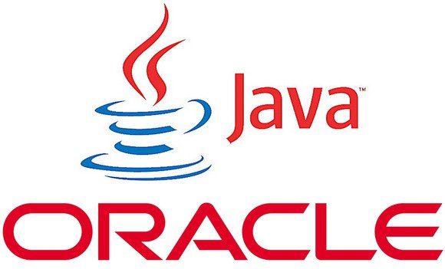

KIRANJIT
MTECH
ANDROID & IPHONE APPS

Slide 2
Point of Discussion
Object Oriented Concepts !
What is encapsulation in java
What is inheritance in java
IS-A and HAS-A relationships
What is method overriding in java
What is method overloading in java
What is constructor in java
What is coupling and cohesion in java

Slide 3
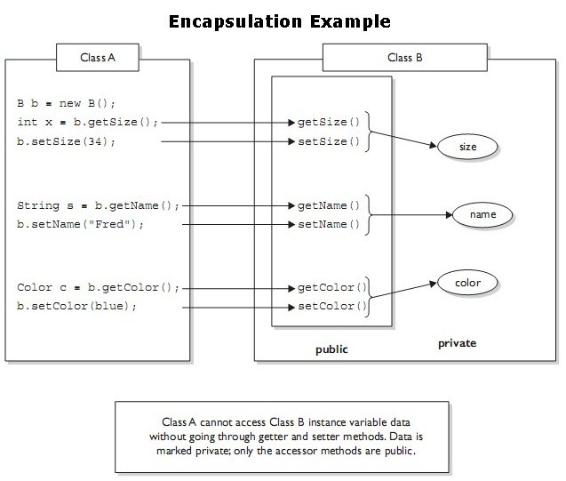
Point of Discussion
Encapsulation:- it binds Code + Data it manipulates

Slide 5
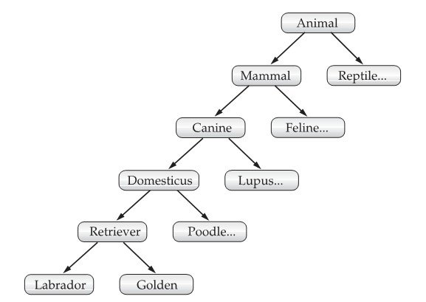
Point of Discussion
What is Inheritance?
Inheritance is the process by which one object acquires the properties of another object.
Why to use ? 1.code resuse 2.to use polymorphism
What is Sub class & Super class

Slide 6
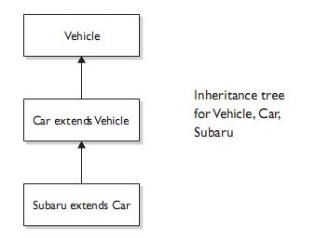
Point of Discussion
Inheritance promotes IS-A relationship
Subaru IS-A Car.

Slide 7
Point of Discussion
PLZ HAVE A LOOK OVER THE PROGRAM
Limitations of Inheritance
You can only specify one superclass for any subclass that you create.
Java does not support the inheritance of multiple superclasses into a single subclass.
You can, as stated, create a hierarchy of inheritance in which a subclass becomes a superclass of another subclass.
No class can be a superclass of itself.
Increases the coupling between classes.

Slide 8
Point of Discussion
IS-A RELATIONSHIP | HAS-A RELATIONSHIP
Inheritance is represented by an is-a relationship. | has-a relationship is represented by composition, association or aggregation.
eg. circle is a shape, and Square is a shape. | eg. car is a complex object that has an engine object.
Tightly coupled code. | Loosely coupled code.
Inherits the states and functions of parent class. | One class is using another class by its instance or object
Both the classes are dependent on each other. | Both the classes are independent.

Slide 9
Point of Discussion
METHOD OVERIDING
RULE1:-method must have same signature & return type.
RULE2:-Methods that are not final, private, or static can be overridden.
Importance:-dynamic method dispatch(DMD)
DMD is mechanism by which a call to a overiden method is resolved during run time rather than compile time.
DMD is called Run time Polymorphism.
(SEE D PRGORAM AND HAVE A CONCLUSION.....)

Slide 10
Conclusion of DMD
if a superclass contains a method that is overridden by a subclass, then when different types of objects are referred to through a superclass reference variable, different versions of the method are executed.
                ? oops..

Slide 11
Point of Discussion
Overloading..........
"Multiple methods with same name but different signatures".
Compile Time Polymorphism.
Example:
public int sum(int a, int b) {
return (a + b);}
// valid method overloading
public float sum(float a, float b) {
return (a + b);}
// Invalid method overloading : change in only return type
public double sum(float a, float b) {
// Duplicate method sum(float, float)
return (a + b); }

Slide 12
Point of Discussion
Constructor has the same name as the class in which it resides and is syntactically similar to a method.
WHAT ABOUT CONSTRUCTORS?
KEYPOINTS:
1.The constructor name must match the name of the class.
2.Constructors can use any access modifier, including private.
3.Constructors must not have a return type.
4.The default constructor is always a no-arg constructor.
5.Interfaces do not have constructors. Interfaces are not part of an object's inheritance tree.
6.can be overloaded. class Horse {
Horse() { } // constructor
void doStuff() {
Horse(); // calling the constructor - illegal!
}
}

Slide 13
Point of Discussion
What is parameterized or overloaded constructor in java.
class Foo {
int size;
String name;
// parameterized constructor
Foo(String name, int size) {
this.name = name;
this.size = size;
}
// That means the following will fail to compile:
Foo f = new Foo(); // won't compile, no matching constructor
// but the following will compile:
Foo f = new Foo("Fred", 43); // No problem. Arguments match with the Foo constructor.

Slide 14
Point of Discussion
Dont worry ..............
              Lastly..................

Slide 15
Coupling
Coupling is the degree to which one class knows about another class.
// Tightly coupled class design - Bad thing
class DoTaxes {
float rate;
float doColorado() {
SalesTaxRates str = new SalesTaxRates();
rate = str.salesRate; // ouch
// this should be a method call:
// rate = str.getSalesRate("CO");
// do stuff with rate
}
}
class SalesTaxRates {
public float salesRate; // should be private
public float adjustedSalesRate; // should be private
public float getSalesRate(String region) {
salesRate = new DoTaxes().doColorado(); // ouch again!
// do region-based calculations
return adjustedSalesRate;
}
}

Slide 16
cohesion
class BudgetReport {
Options getReportingOptions() {
}
void generateBudgetReport(Options o) {
}
}
class ConnectToRDBMS {
DBconnection getRDBMS() {
}
}
class PrintStuff {
PrintOptions getPrintOptions() {
}
}
class FileSaver {
SaveOptions getFileSaveOptions() {
}
}
Instead of one class that does everything, we have broken the system into four main classes.

Slide 17
NO QUESTION PLZZZZ...
?

Slide 19
Now its my turn
Can we overload a constructor ?

Slide 20
Is multiple inheritance supported in java ?

Slide 21
Dynamic method despatch is __________ time Polymorphism.
            ?

Slide 22
OVERLOADING is a ______________ time Polyorphism.

Slide 23
Which approach is better ?
Cohesion or Coupling

Slide 24
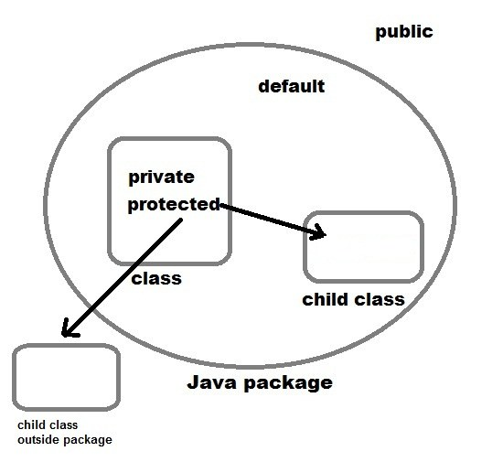

Slide 25
THANK YOU

